Slide 1
Clustering and PCA Assignment
Submitted By:
Jetendra Mulinti

Slide 2
Problem Statement
HELP International is an international humanitarian NGO that is committed to fighting poverty and providing the people of backward countries with basic amenities and relief during the time of disasters and natural calamities.
After the recent project that included a lot of awareness drives and funding programs, they have been able to raise around $ 10 million. Now the CEO of the NGO needs to decide how to use this money strategically and effectively. The significant issues that come while making this decision are mostly related to choosing the countries that are in the direst need of aid. The NGO wants to know:
The categories of countries using some socio-economic and health factors that determine overall development of the country. The countries which the CEO needs to focus on the most.
Based on various market surveys, the NGO has gathered a large dataset containing the socio-economic factors of the countries.

Slide 3
Objectives
Our main task is to cluster the countries by socio economic factors mentioned above and present a solution.
We are supposed to use dimensionality reduction using PCA to get the visualizations of the clusters in a 2-D form.

Slide 4
Data Pre Processing
Removing the Nan values
Performing EDA process
Understanding the Data
Outliers Treatment
Principal Component Analysis

Slide 5
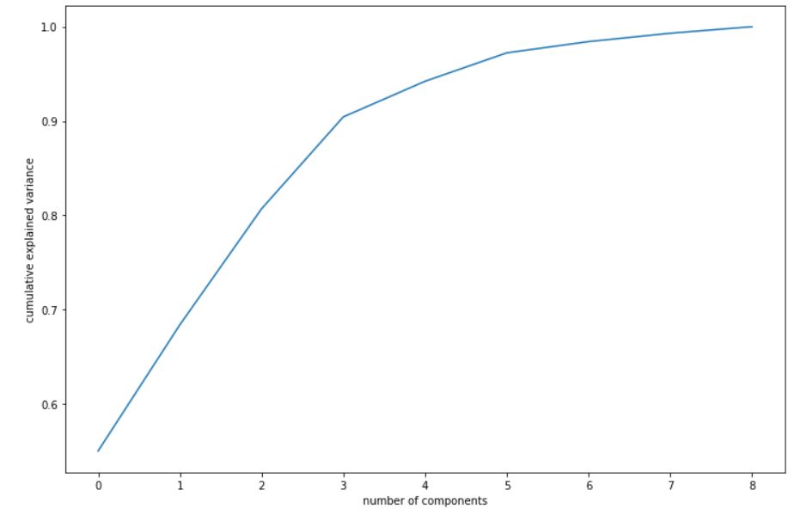
PCA
Beside Graph 5 components are enough to describe 95% of the variance in the dataset.
We'll choose 5 components for our clustering

Slide 6
Clustering:
We use both K means and Hierarchical Clustering on our 5 pca components.
For K means Clustering we take K = 5 Nearest Neighbours
We got a Hopkins Statistic value = 0.72

Slide 7
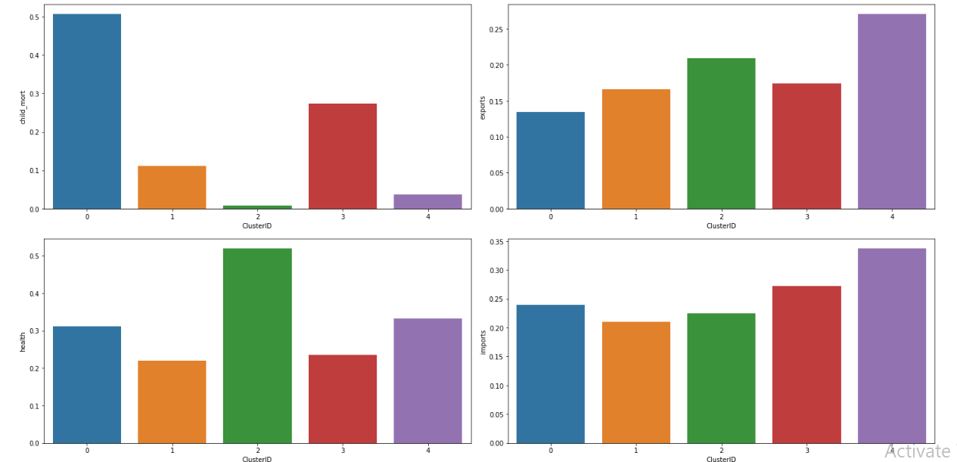
Clustering:

Slide 8
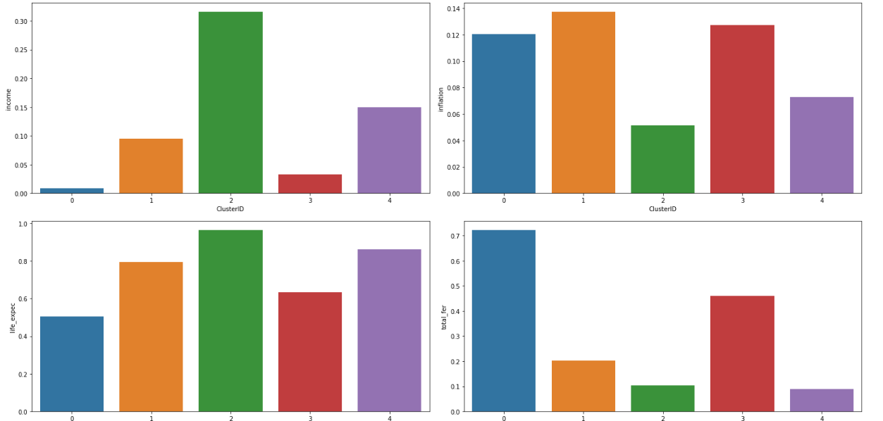
Clustering:

Slide 9
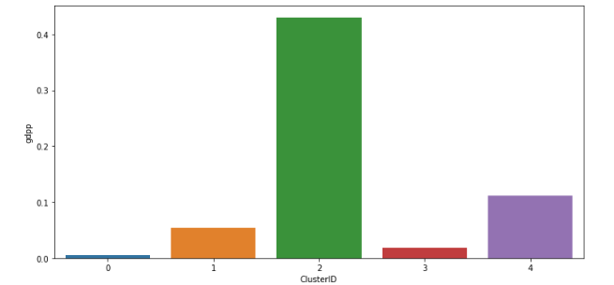
Clustering:

Slide 10
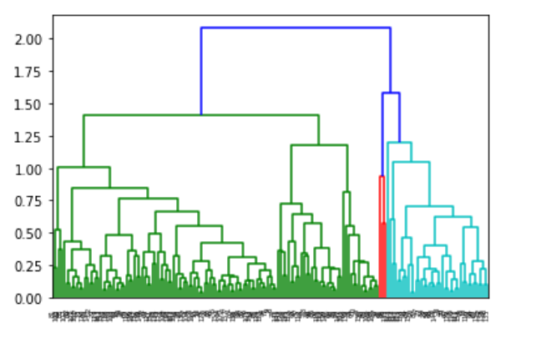
Hierarchical Clustering

Slide 11
Conclusion
Steps followed:
With all the socio economic data provided we carried out data cleaning, data preparation to confirm the data is ready for further analysis
In PCA we found out 5 components.
Hopkins Statistic with 0.72 shows that formation of clusters is highly likely
Finally mean of different factors were plotted for all the clusters
Clusters with low income, low GDPP, high child mortality will be considered for maximum fund investment.
Countries belonging to such categories can be seen in the end result of the code.

